Slide 1
The European Network for the Accreditation of Engineering Education (ENAEE) and the EUR-ACE® label
ENAEE Annual Assembly
by Iring Wasser, ENAEE
12 November 2012
1

Slide 2
Members of ENAEE
Engineering (Education) Societies and Organizations | Engineering Accreditation Agencies | Others
FEANI | ASIIN | CoPI
SEFI | CTI | Unifi
Eurocadres | Engineering Council | BBT
Danish Society of Engineers | Engineers Ireland
Instituto de la Ingenieria de Espana | MÜDEK
CLAIU | Ordem dos Engenheiros
IGIP | RAEE
Finish Association of Graduate Engineers | QUACING
 | ARACIS
6 November 2012
Iring Wasser, ENAEE

Slide 3
Organisational Structure of ENAEE
General Assembly
(20 members organisations)
Label Committee
( 9 Representatives of authorized agencies)
Organizes the authorization procedures for QAA
elects
Authories
EI
Müdek
OE
RAEE
EngC
CTI
ASIIN
Administrative Council
(9 members, incl.
2 Vice-Presidents, Treasurer – President)
ARACIS
Carry out accreditation processes at national HEIs
Check if outcomes are fulfilled
Award EUR-ACE label in addition to national accreditation
QUACING
Policy-making body
Implementation and dissemination
Higher Education Institutions
seeking the EUR-ACE label
6 November 2012
Iring Wasser, ENAEE
Notes:
60

Slide 4
The EUR-ACE system is based on a decentralized approach
Programme fulfilling the EUR-ACE learning outcomes can be awarded the EUR-ACE label not by ENAEE itself, but by one of the authorized agencies – in some countries, one accreditation process gives more than one label. HEI have the free choice with which agency to collaborate
To become an authorized agency, it has to undergo a review process and show compliance with the EUR-ACE criteria (including the ESG) - next year 7 agencies will have to undergo the reauthorization process
6 November 2012
Iring Wasser, ENAEE

Slide 5
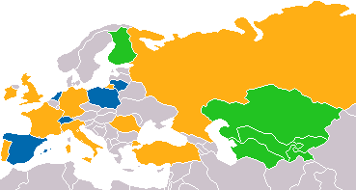
Europe and the EUR-ACE system
Legende
Yellow: countries with agencies authorized to deliver the EUR-ACE label
Blue: Countries with agencies being under review to deliver the „EUR-ACE „label
Green: Mentoring
6 November 2012
Iring Wasser, ENAEE

Slide 6
Candidate agencies in the review process – new challenges
OAQ, Switzerland
SKVC, Lithuania
KAUT, Poland
NVAO, Netherlands
IIE/AQU, ANECA, Spain
6 November 2012
Iring Wasser, ENAEE
Notes:
7

Slide 7
Number of EUR-ACE® Labels
500
400
300
200
100
0
estimation for 2012:
Altogether around 1100
labels
6 November 2012
Iring Wasser, ENAEE

Slide 8
Number of EUR-ACE® Labels (as of 30 October 2012)
ASIIN | EI | CTI | AEER | EngC | OE | MUDEK
384 | 115 | 292 | 107 | 31 | 16 | 145
 |  |  |  |  | Total: | 1090
6 November 2012
Iring Wasser, ENAEE

Slide 9
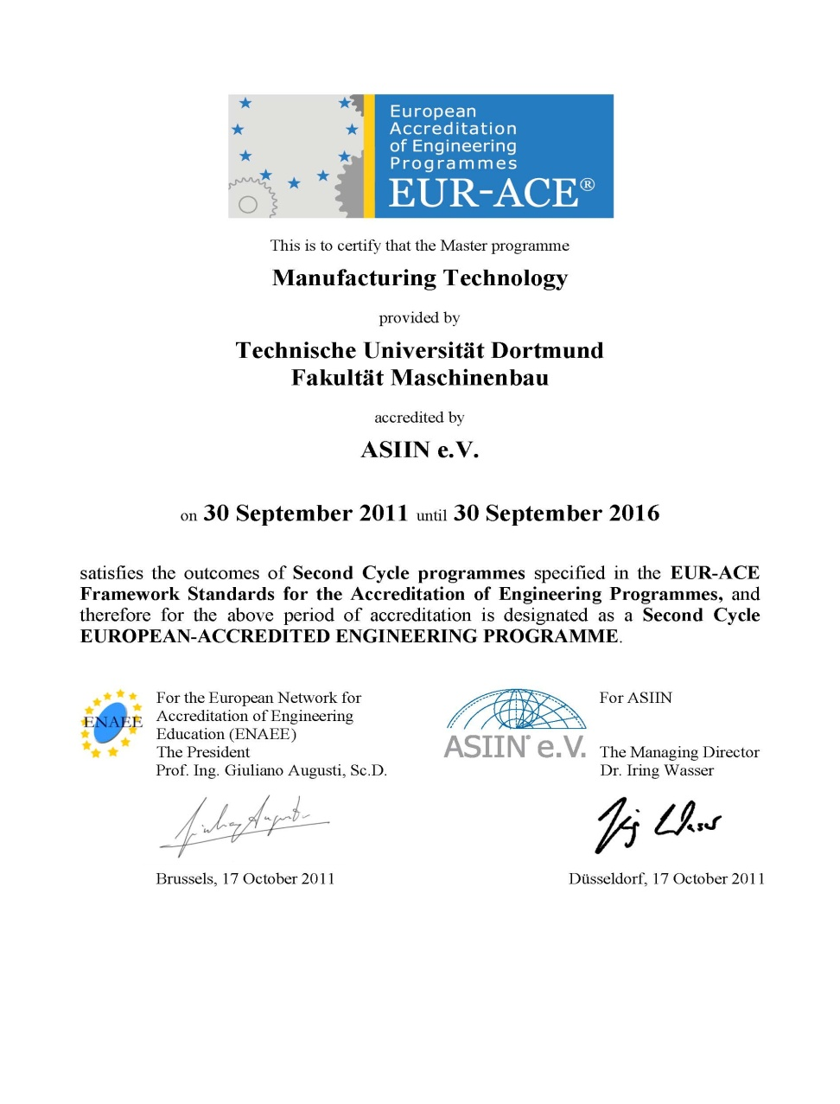
The EUR-ACE® Certificate
6 November 2012
Iring Wasser, ENAEE

Slide 10
Benefits for HEIs
Assurance that programme meets quality standards set by the European engineering community
In some cases the EUR-ACE accreditation might develop the capacity to substitute state recognition of programs; automatic inclusion in the FEANI index; First step for the European professional card
Benchmarked against other European programmes
Reliable information on quality of FC programme for admission for SC
Incentives for students to choose EUR-ACE labelled programmes; EC has identified “EUR-ACE” as best practice in European
6 November 2012
Iring Wasser, ENAEE

Slide 11
Benefits for students
Assurance that EUR-ACE ® labelled programme meets high European and international standards
Facilitates horizontal and vertical mobility application to EUR-ACE® Bachelor and Masters programmes in other HEIs
Additional quality label recognized by employers in Europe
International recognition of degree as meeting professional standards
Regulatory bodies accept EUR-ACE® labelled programmes as meeting requirements for becoming chartered engineer
6 November 2012
Iring Wasser, ENAEE
Notes:
52

Slide 12
Benefits for employers
Successful completion of EUR-ACE labelled programme assures:
Competences of graduates: Candidate‘s knowledge, understanding and practical capabilities meet international standards
Reliable information on quality of degree program
Not only academic standard of programme checked but also relevance for profession
Complement to Diploma Supplement
6 November 2012
Iring Wasser, ENAEE
Notes:
53

Slide 13
Benefits for accreditation agencies
6 November 2012
Iring Wasser, ENAEE
Offering additional quality label to customers (HEIs)
Certification of quality of accreditation agency according to ESG and employers’ requirements
Alternative Route into the EQAR?
Integration into European network of engineering professionals
Possibility to accredit in other European countries and beond in which no authorized agency are operating

Slide 14
Benefits for professional engineers organizations
Guarantee that graduates meet educational requirements for entering into their registers (if organisation has set its educational standard at EUR-ACE level)
FEANI automatically includes the EUR-ACE® accredited programmes in its Index of European recognized engineering programmes
6 November 2012
Iring Wasser, ENAEE
Notes:
55

Slide 15
ENAEE Philosophy with regard to the EUR-ACE criteria
The European disciplinary LO for FCD/SCD have been developed by an encompassing alliance of stakeholders and are intended to:
be widely applicable and inclusive, enabling eligibility of a wide range of possible approaches to higher education
handle the diversity of content of degree programs
be relevant for academic study programs leading to a First or to a Second Cycle Degree
Define qualification as entry routes to the engineering profession
facilitate in particular accreditation of trans-national joint- and double degree programs
At the level of external QA activities, these LO are always seen in combination with the ESG
6 November 2012
Iring Wasser, ENAEE

Slide 16
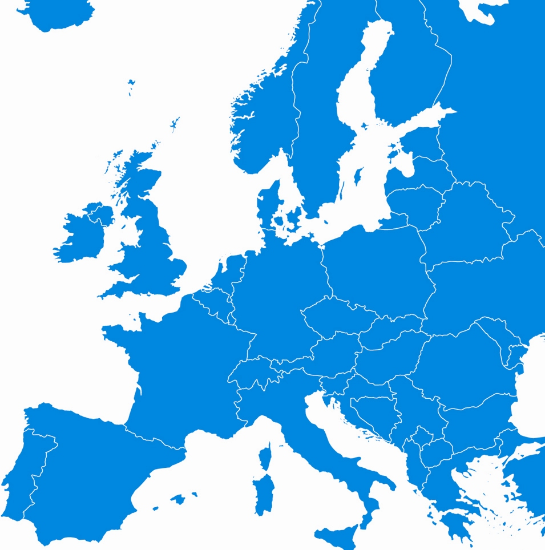
The Introduction of a Professional Card in Europe: The example of the
engineerING card
6 November 2012
Iring Wasser, ENAEE

Slide 17
EUR-ACE and the Engineering Card as an answer to impediments to professional mobility?
Lacking transparency on the job market
Different degrees and complicated acceptance procedures have hampered the change of employment in European Countries and between European Countries.
EU Mobility Regulation of 2005
The EU therefore demands the mutual acceptance of the competencies required to carry out a profession in order to eliminate impediment at the change of employment between individual member states in the long-term.
6 November 2012
Iring Wasser, ENAEE

Slide 18
Objectives of the engineerING card
  Promotion of EU-wide mobility of engineers in accordance with the European Directive 2005/36/EG on the recognition of professional qualifications
Profile shaping and further development of the profession through orientation on European-wide standards
Strengthening of the engineering community through transparency of the engineer status, individual degrees and intensified identification
6 November 2012
Iring Wasser, ENAEE

Slide 19
Verification Standards
Applicant identity will be verified by original or certified ID, or trusted third party attestation
Academic qualification will be validated
  that the applicant holds the qualification by certified copy, preferably verified with the university
  that the qualification meets the standards by EUR-ACE equivalence
Work experience will be validated by confirmation from employer / client or trusted third party
Continuing education will be validated by certificates
6 November 2012
Iring Wasser, ENAEE

Slide 20
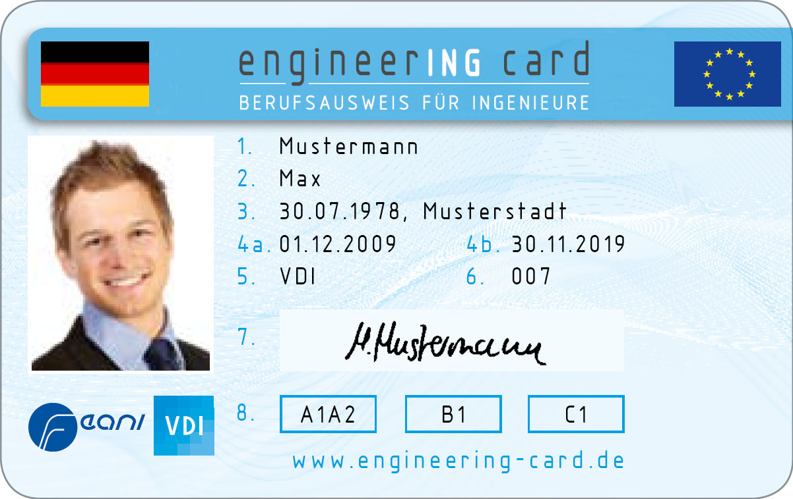
engineerING card: Front
Given Name
Surname
Date and Place of Birth
4a Date of Issue
4b Date of Expiry
Member of Association/
Organisation
ID Number
Signature
Key for qualifications
6 November 2012
Iring Wasser, ENAEE

Slide 21
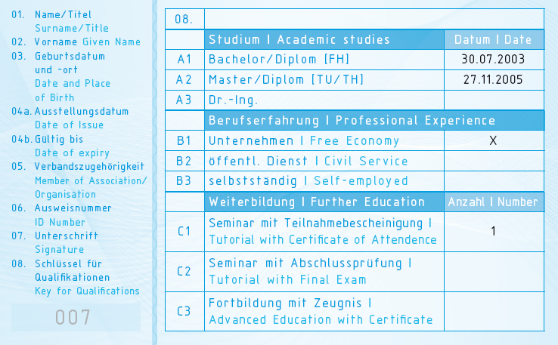
engineerING card: Back
Academic Studies
Professional Experience
Continuing Education
Legend of classification of the front of the card
6 November 2012
Iring Wasser, ENAEE

Slide 22
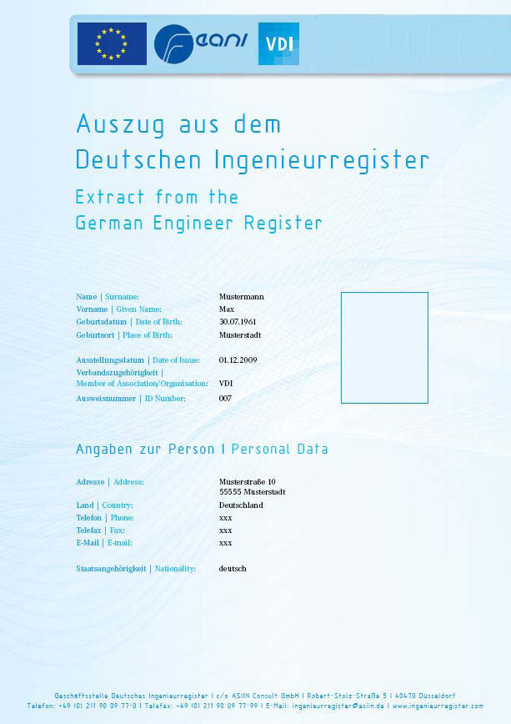
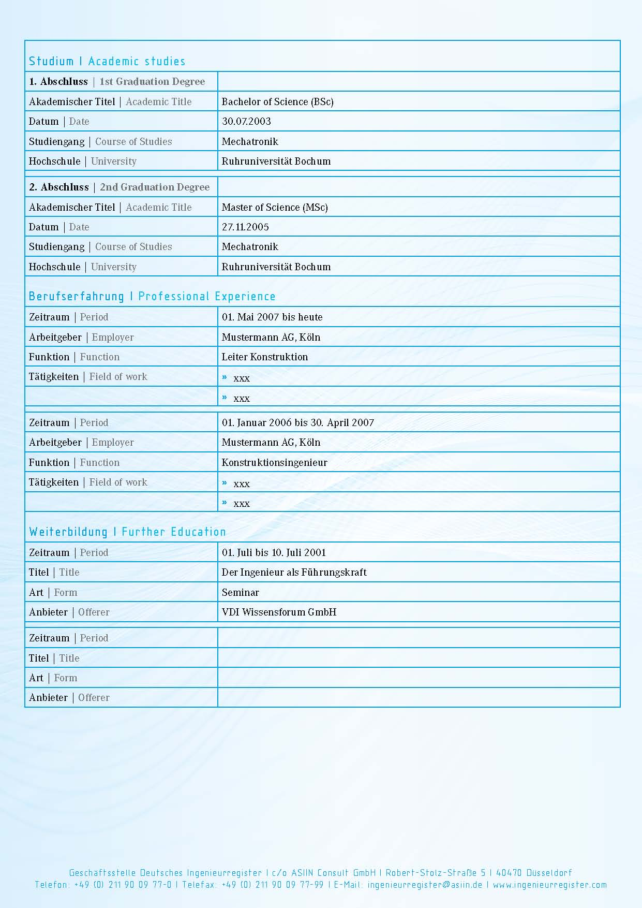
The Register Data Sheet Features all Important Details
Academic Studies
Professional Experience
Continuing Education
Personal Details
6 November 2012
Iring Wasser, ENAEE

Slide 23
Current Challenges for ENAEE as an organization
ENAEE has been growing rapidly since the start of the European Standing Observatory for the Engineering Profession back in 2011. After more than 10 years of an organization it is time for critical self reflection and a Bestandsaufnahme. Is there a need for professionalization of management structures within ENAEE?
We have a diverse membership. ENAEE is not just an assembly of accreditation agencies but has a wide array of stakeholders on board: How can we best arrive at synergies between ENAEE and its members?
The engagement of and interaction with employers/recognition authorities/politics has not reached a satisfactory level: how do we manage to become a partner for the employer side and how do we become more visible in the political arena?
In terms of international networking, ENAEE and the International Engineering Alliance are among the most prominent networks – how do we manage to cooperate more closely for the benefit of global mobility?
25
6 November 2012
Iring Wasser, ENAEE

Slide 24
Current Challenges for the “EUR-ACE” system as a tool to foster academic and professional mobility and mutual acceptance of accreditation decisions
The time has come for a review of the EUR-ACE Learning Outcomes/ (engineering) graduate attributes. In the international arena there is an ongoing competition of upgrading LO and qualification frameworks/raising the bar/: to which degree is this reflected in the real educational improvements in engineering programs?
Thus far, there is no system in place to measure learning outcomes reliably across national boundaries; whereas in the field of secondary school there are instruments like the PISA study, no such methods are in place in the field of HE – will AHELO provide new tools?
In spite of all the rhetoric of Graduate Attributes /LO, many MRAs rely on input criteria or on procedural similarities – how do we arrive at MRAs which are worth the paper on which they are written? How do we define their added value? How can our activities become more relevant in terms of providing a real service to graduates and employers?
6 November 2012
Iring Wasser, ENAEE

Slide 25
Contact
Dr. Iring Wasser
President ENAEE
Managing Director ENAEE
Mail: gf@asiin.de
Web: www. enaee.eu
phone: +49 (0)211 / 900 977 -10
6 November 2012
Iring Wasser, ENAEE

