Slide 1
ACCREDITATION OF ENGINEERING PROGRAMMES CONSIDERING PROFILES (SPECIALIZATIONS)
Alexander Chuchalin,
ENAEE Promotion Committee, chai@tpu.ru

Slide 2
The ENAEE Promotion Committee was established in 2012 aiming to give an incentive to the EUR-ACE System of Accreditation of Engineering Education in Europe and worldwide.

Slide 3
Observation of engineering programme (EP) accreditation approaches offered by ENAEE authorized national Agencies considering various profiles (specializations) of the programmes was planned to develop ENAEE policy in this particular area.
Notes:
The action plan includes…

Slide 4
The profile (specialization) of EP is considered to be a part of the programme that provides graduates’ orientation in specific types and (or) objects of their professional activity.

Slide 5
The Questionnaire for ENAEE authorized Agencies has been prepared and disseminated to receive information necessary for analysis.

Slide 6
Firstly the ENAEE authorized Agencies were asked to describe the structures of EPs with profiles in view (modules, internship, graduation projects, etc.).

Slide 7
The second question to ENAEE authorized Agencies related to the experience in accreditation of EPs with more than one profile of graduate training.

Slide 8
Every Agency in its practice faces the accreditation of EPs providing more than one profile (specialization).
In accordance with the information given by the Agencies, the approaches to accreditation of such programmes are different.

Slide 9
The third question concerned on-site visits organization in different cases including accreditation of either the whole engineering programme or its separate profiles.

Slide 10
The last question to the Agencies directly related to the cost of evaluation procedure in cases of multi-profile EP accreditation.

Slide 11
Based on the analysis of information received from ENAEE authorized Agencies the recommendation on the ENAEE approach to accreditation of EPs considering various profiles (specializations) was developed.

Slide 12
Nomenclature and Structure of Engineering Programs
In UK, engineering programmes with several profiles are accredited by ECUK as a whole.
However, some profiles can be considered as non-accredited in frames of the wider programme (Mechanical Engineering, Civil Engineering, Electronic Engineering, etc.).

Slide 13
Nomenclature and Structure of Engineering Programs
In France, Ireland, Turkey and Portugal engineering programmes are accredited by CTI, EI, MUDEK and OE as a whole as well.
Though, each programme profile should be compliable with the accreditation criteria.

Slide 14
Nomenclature and Structure of Engineering Programs
In Germany, ASIIN provides either accreditation of the whole programme (Electrical Engineering, Chemical Engineering, Power Engineering), or each profile (specialization) separately (Light Construction and Simulation, Renewable Energy and Energy Efficiency) depending on the number of profiles within the EP, their breadth and depth.

Slide 15
Nomenclature and Structure of Engineering Programs
The AEER accredits EPs that implement the State Educational Standards of the 2nd generation (SES-2) issued by the Russian Ministry of Education in 2000. The SES-2 includes the list of 44 two-cycle Engineering Programs (Bachelor- Master) and the list of 312 Diploma Specialist Programmes in engineering (5-year integrated programmes).

Slide 16
Nomenclature and Structure of Engineering Programs
The State Educational Standards of the 2nd generation envisaged implementation of two models: 4+2 – model (4-year Bachelor + 2-year Master) and 4+1 - model, i.e. exercising 4-year Bachelor Programme and then mastering Diploma Specialist Programme for 1 year.

Slide 17
Nomenclature and Structure of Engineering Programs
According to SES-2, Bachelor Programmes were not envisaged any profiles because of the long list of Diploma Specialist Programmes that were essentially profiles (specializations) of graduate training (4+1 model).
Thus, currently the AEER accredits a FCD Engineering Programme as a whole.

Slide 18
Nomenclature and Structure of Engineering Programs
In 2011 the Federal State Educational Standards of the 3rd generation (FSES-3) was introduced in Russia.
These new Standards do not envisage implementation of the 4+1 model. However, the Standards give Russian universities the right to design FCD EPs in major areas with different profiles of graduate training.

Slide 19
Nomenclature and Structure of Engineering Programs
Currently, the FSES-3 includes the list of 100 major areas for designing FCD EPs: Electrical Engineering, Mechanical Engineering, Computer Engineering, etc.
Herewith, the number of profiles for some of major areas can reach two dozen.

Slide 20
Nomenclature and Structure of Engineering Programs
For example, the FCD EP in Electrical and Power Engineering envisages 19 profiles: High-voltage Electrical and Power Engineering, Alternative and Renewable Energy Sources, Relay Protection and Automation of Electric Power System, Electric Power Plants, Electric Power Systems and Networks, Hydropower Plants, Electric Power Supply, Electrical and Electronic Equipment, Electric Transport, etc.

Slide 21
Nomenclature and Structure of Engineering Programs
The 4-year (240 ECTS credits) FCD EP in Russia normally consists of five parts:
Humanities and Social Sciences (30–40 ECTS credits),
Natural Sciences and Mathematics (55–65 ECTS credits),
Basic Engineering (55–65 ECTS credits) and Variable Engineering (65–75 ECTS credits),
Industrial Internship (8 ECTS credits),
Graduation Project (12 ECTS credits).

Slide 22
Nomenclature and Structure of Engineering Programs
According to FSES-3, the profile of the FCD EP can be tailored due to the different content of elective Humanities and Social Sciences modules (≤ 7 ECTS credits), elective Natural Sciences and Mathematics modules (≤ 12 ECTS credits), Basic Engineering modules (30–40 ECTS credits) and Variable Engineering modules (35–45 ECTS credits).

Slide 23
Nomenclature and Structure of Engineering Programs
Specific topics of Industrial Internship (8 ECTS credits) and Graduation Project (12 ECTS credits) contribute to graduate profile orientation as well.
Thus, considering different profiles, the FCD EP in major areas may vary in content at 1/3 or even 1/2.

Slide 24
Nomenclature and Structure of Engineering Programs
Engineering Program Modules | ECTS | Profile ECTS
Humanities and Social Sciences basic modules variable & elective modules | 30 – 40 15 – 20 15 – 20 | 0 – 8
Natural Sciences and Mathematics basic modules variable & elective modules | 55 – 65 25 – 35 25 – 35 | 0 – 12
Engineering basic modules general profile variable modules general profile | 125 – 135 55 ‑ 65 20 ‑ 30 30 – 40 65 – 75 25 ‑ 30 35 – 45 | 30 – 40 35 – 45
Industrial Internship | 8 | 8
Graduation Project | 12 | 12
Total | 240 | 85 – 125

Slide 25
Nomenclature and Structure of Engineering Programs
For the time being, the Association for Engineering Education of Russia is developing the approach to accreditation of FCD EPs with different profiles.

Slide 26
Nomenclature and Structure of Engineering Programs
Change in the approach to accreditation of EPs with profound differences in profiles of graduates training inevitably results in change the needs for human, temporal and financial resources necessary for reliable expertise for compliance of a programme with the accreditation criteria.

Slide 27
Nomenclature and Structure of Engineering Programs
According to information received from the ENAEE authorized Agencies, there are different approaches to organization of on-site visits for the EP evaluation considering the profiles and allocation of resources.

Slide 28
Resources for Engineering Programs Accreditation
In UK accreditation of EPs is carried out by professional organizations licensed by the ECUK.
Accreditation team usually consists of 3-5 experts depending on the number of the programmes.

Slide 29
Resources for Engineering Programs Accreditation
Accreditation on-site visits to UK universities usually last 2 days.
Special emphasis is placed on analysis of documents. If the volume of the materials submitted for expertise is large (due to number of the programmes and/or profiles), the time of preparatory work may be expanded.

Slide 30
Resources for Engineering Programs Accreditation
In Germany ASIIN accreditation visit is carried out by commission consisting of 5 experts usually including 3 representatives of academia, one of industry and a student. Each expert works with definite criteria for engineering programmes evaluation.

Slide 31
Resources for Engineering Programs Accreditation
The number of experts in ASIIN commission can be increased in case of cluster accreditation of the programmes on adjacent training profiles. A visit to the university normally takes not more than one day, and another half of the day is required for experts’ meeting.

Slide 32
Resources for Engineering Programs Accreditation
In Ireland the EI team evaluating EPs consists of 3 experts. In case of evaluating programmes with different profiles (specializations), an additional commission is formed to assess each profile. The accreditation on-site visit lasts 2 full days.

Slide 33
Resources for Engineering Programs Accreditation
In Portugal the OE commission consists of 3-4 experts. If a programme envisages several profiles, each of them is assessed by at least two experts. The OE commission on-site visit to university takes 2 days.

Slide 34
Resources for Engineering Programs Accreditation
In Turkey the number of experts in the MUDEK team depends on the number of EPs submitted for accreditation.
As a rule, two experts are chosen to evaluate each program.
A visit to university lasts 3 days irrespective of the number of the evaluated programmes.

Slide 35
Resources for Engineering Programs Accreditation
The AEER commission accrediting EPs in Russian universities consists of 3 experts representing academia plus one expert from industry. The commission is supported by the employee of the AEER Accreditation Centre.
The commission work lasts 3 days.

Slide 36
Resources for Engineering Programs Accreditation
The representative of industry is engaged just for one day.
When accrediting the cluster of programmes on adjacent disciplines, the number of experts increases.
Normally no more than 3 related EPs can be evaluated during one on-site visit.

Slide 37
Resources for Engineering Programs Accreditation
While developing the approach to accreditation of FCD EPs with different profiles, AEER plans to optimize human and temporal resources necessary for evaluation of EPs considering their structure and content.
As a result, the cost of accreditation is minimized.

Slide 38
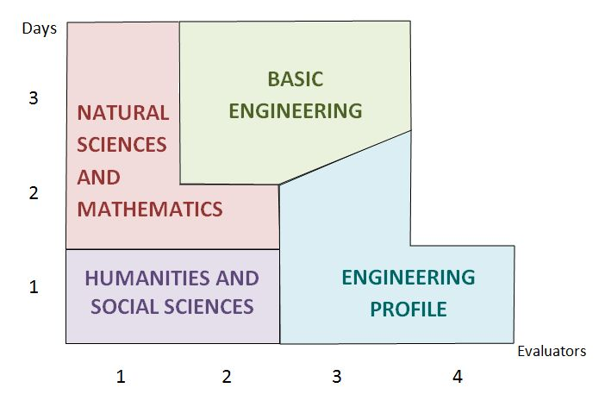
Resources for Engineering Programs Accreditation
The fig. shows the diagram of human and temporal resources allocation while evaluating the one-profile EP.

Slide 39
Resources for Engineering Programs Accreditation
The work of 3 academia experts during 3 days and one industry expert during one day represents the general resource of the evaluation visit equal to 3 × 3 + 1 × 1 = 10 man-days.

Slide 40
Resources for Engineering Programs Accreditation
The experience of the AEER Accreditation Centre shows that evaluation of the programme in part of Humanities & Social Sciences and Natural Sciences & Mathematics requires about 4.5 man-days.

Slide 41
Resources for Engineering Programs Accreditation
To evaluate the programme in Engineering, 5.5 man-days are required, including 2.75 man-days (50 %) to evaluate the Engineering programme in profile.

Slide 42
Resources for Engineering Programs Accreditation
Thus, the evaluation of the profile requires about ¼ of all resources necessary to evaluate the EP as a whole.
This means that evaluation of the two-profile programme will require 2.75 additional man-days.

Slide 43
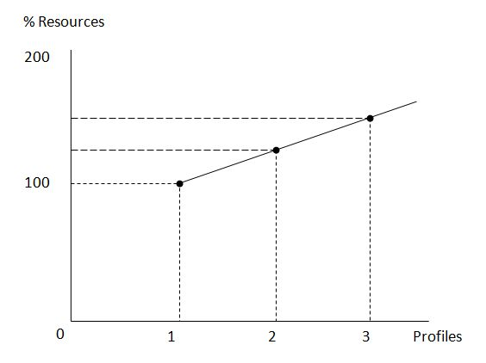
Resources for Engineering Programs Accreditation
Accordingly,
the cost of the 2-profile
programme
evaluation
increases by 25%.
With 3-profile
programme,
necessary resources
grow by another 25%, etc.

Slide 44
Resources for Engineering Programs Accreditation
As a result, the cost of accreditation of the N-profile EP is calculated by formula
C = C₁ × (0.75 + N × 0.25)
С₁ – is the cost of AEER accreditation of one-profile programme.
While accrediting N-profile programme, the AEER plans to certify each profile, i.e. the number of certificates will equal to the number of the programme profiles.

Slide 45
Resources for Engineering Programs Accreditation
As long as the AEER is an ENAEE authorized Agency and issues additional certificates (EUR-ACE Label), the cost of the ENAEE service can be calculated by formula similar to the given above
С_{ENAEE} = C_{ENAEE 1} × (0.75 + N × 0.25)
C_{ENAEE 1} – is the cost of EUR-ACE Label for one-profile programme.

Slide 46
Resources for Engineering Programs Accreditation
The presented approach to accreditation of multi-profile EPs is considered to be reasonable.
The approach could be recommended for implementation by all the ENAEE authorized Agencies.

Slide 47
Thank You
for Your Attention!

